Slide 1







Enterprise Blockchain Developers (Intermediate)
In support of
Powered By

Slide 2
Outline
Dive into Proxy
Web3 Intro
Web3 React Interaction
© 2017-2020 SmartMesh Foundation Pte. Ltd. | MeshBox Foundation Pte. Ltd.

Slide 3
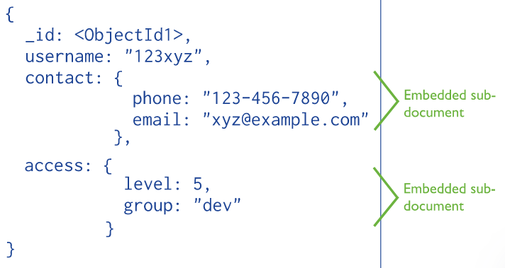
DataBase Design
Embedded Data Models: you may embed related data in a single structure or document

Slide 4
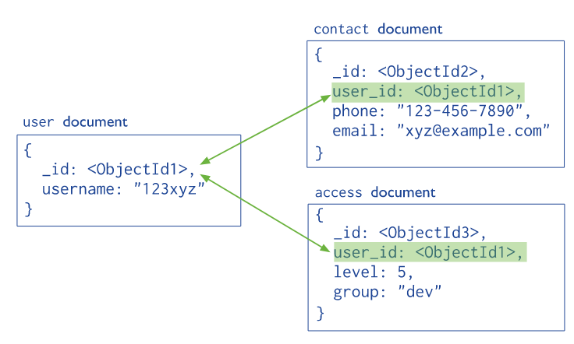
DataBase Design
Normalized Data Models: Normalized data models describe relationships using references between documents

Slide 5
DataBase Design
How to design an embeded data model
One to One Relationship
One to Many Relationship
Many to Many Replationship

Slide 6
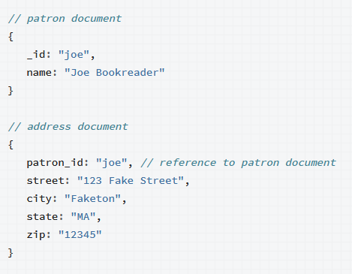
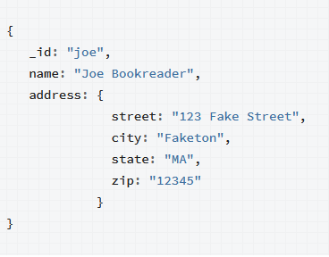
DataBase Design
One to One Relationship

Slide 7
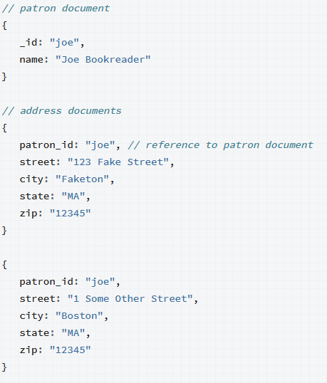
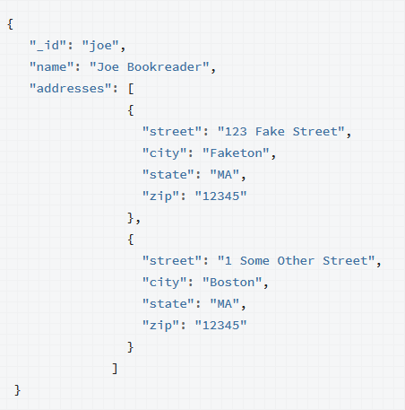
DataBase Design
One to Many Relationship and subset pattern

Slide 8
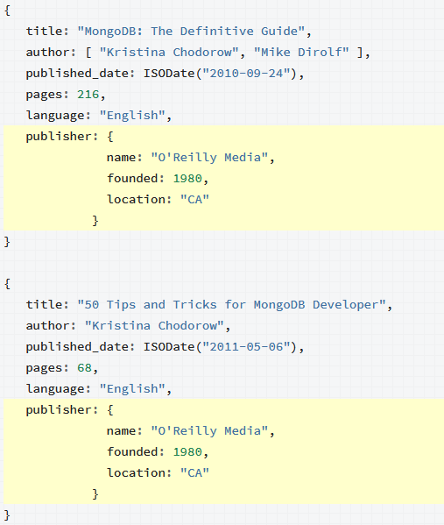
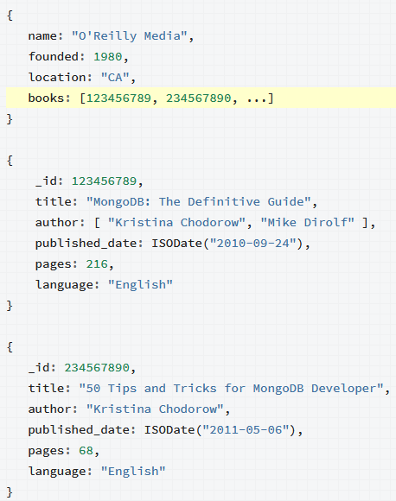
DataBase Design
One to Many Relationship with reference

Slide 9
DataBase Design
Solidity Data Design
Mappings, Arrays, and Struct
Mappings: Key - Value
mapping (address => uint) userBalances;
Arrays:
address[] userIndex;
userIndex.push(anAddress);
Strut:
struct UserStruct {
bytes32 userEmail;
uint userAge;}

Slide 10
DataBase Design
1) A struct, for record details. It will contain all the fields except the key.
2) A mapping of keys to struct instances.
3) An array that will be an unordered index of keys. In the example, these are user addresses.

